Slide 1
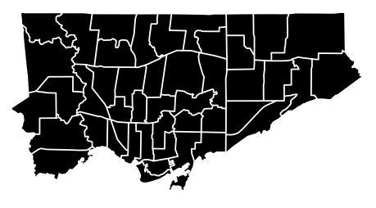
Clustering Toronto boroughs and neighborhoods by restaurants’ cuisines
Coursera capstone project by Eve Belyaeva

Slide 2









The goal of the project
The goal of the project is to combine information about restaurant count in neighborhoods containing different cuisines
It is important if the customers wish to find a place with kitchen they prefer and also to have a number of these places

Slide 3
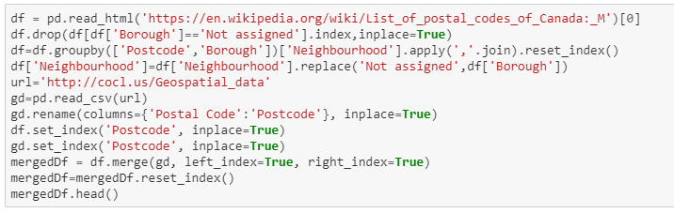
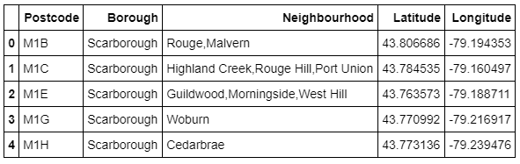
Gather dataset Toronto boroughs and neighborhoods

Slide 4
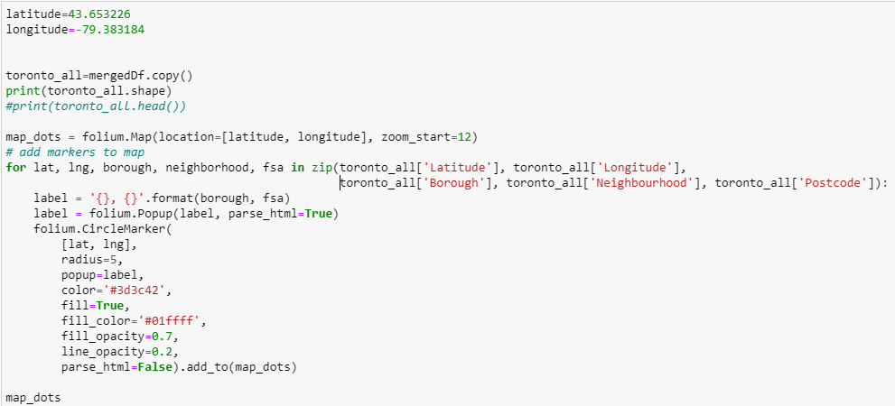
Code snippet for the map

Slide 5
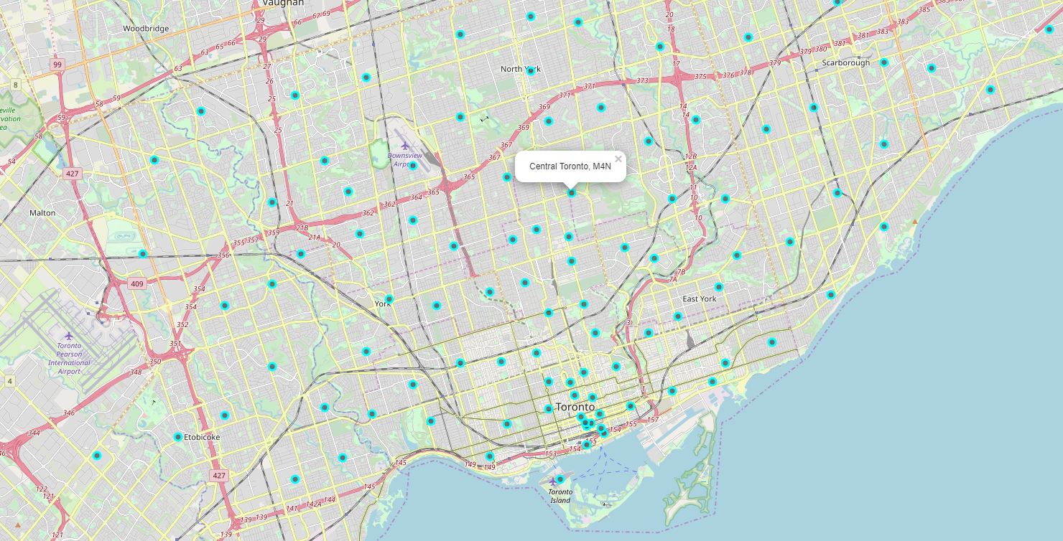
Toronto boroughs on map

Slide 6
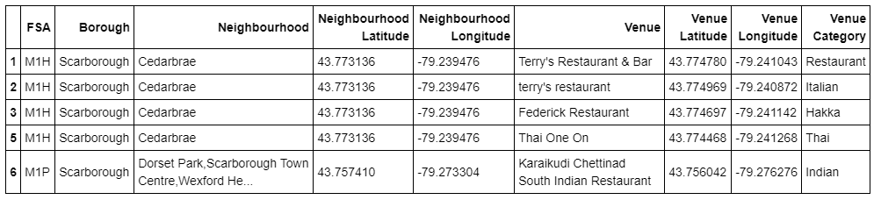
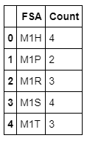
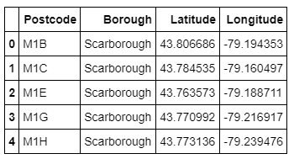
Gathering restaurants data from FourSquare and preparing the data for choropleth map

Slide 7
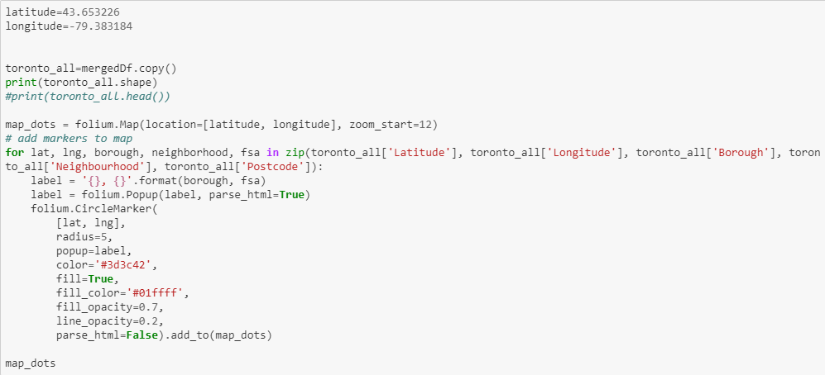
Code snippet for the map

Slide 8
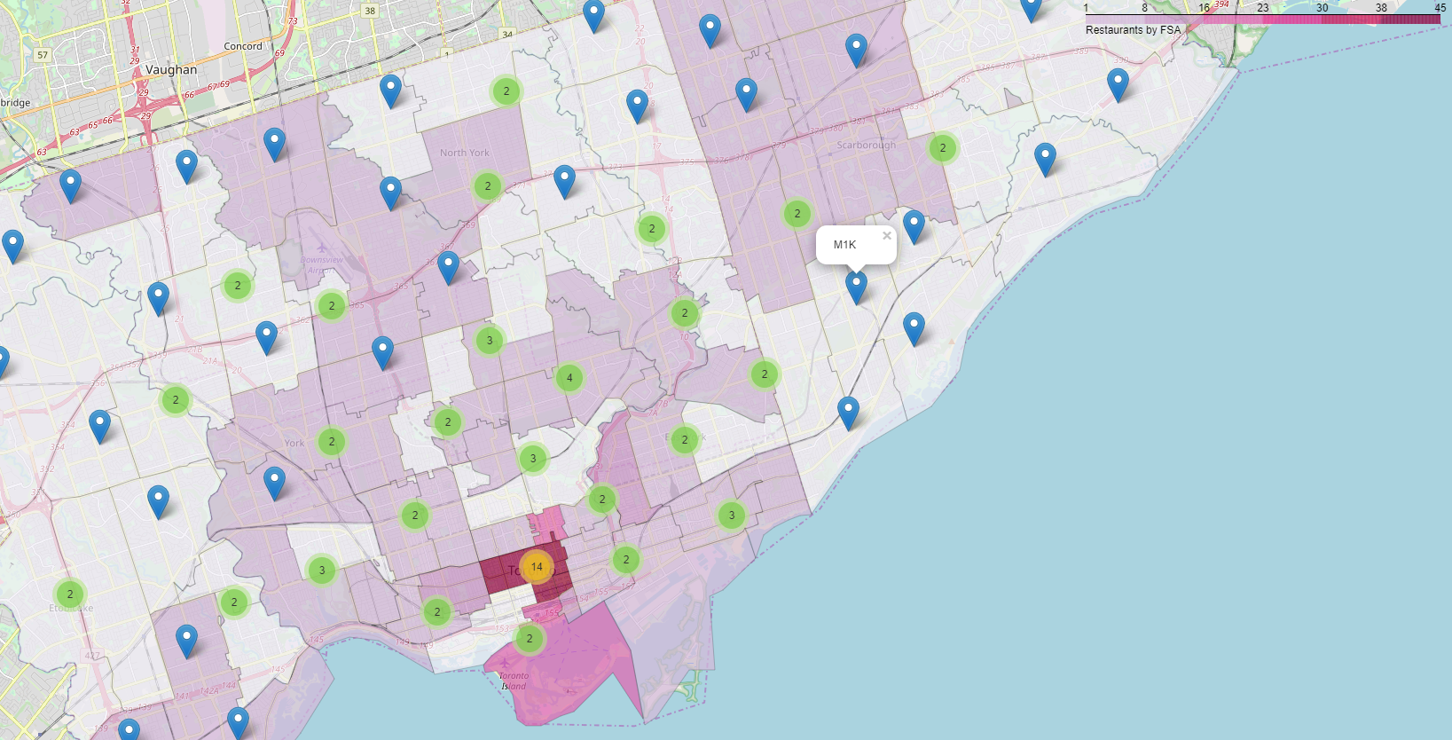
Choropleth map based on restaurants count in Toronto boroughs

Slide 9
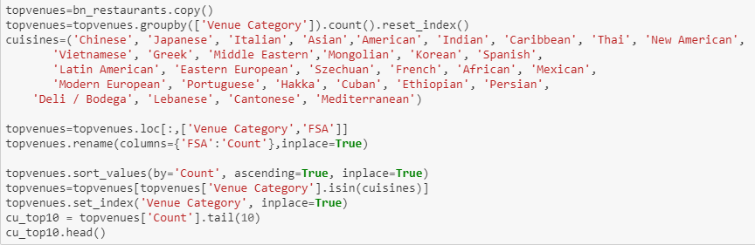
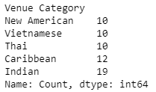
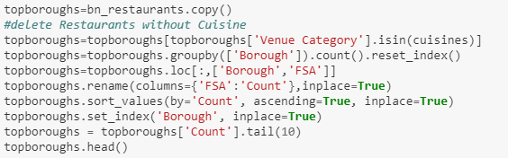
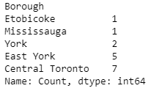
Preparing the data to search for different cuisines distribution in boroughs

Slide 10
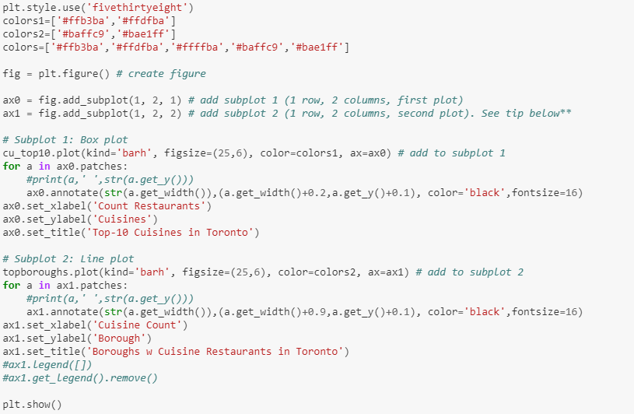
Code snippet for the barh plots

Slide 11
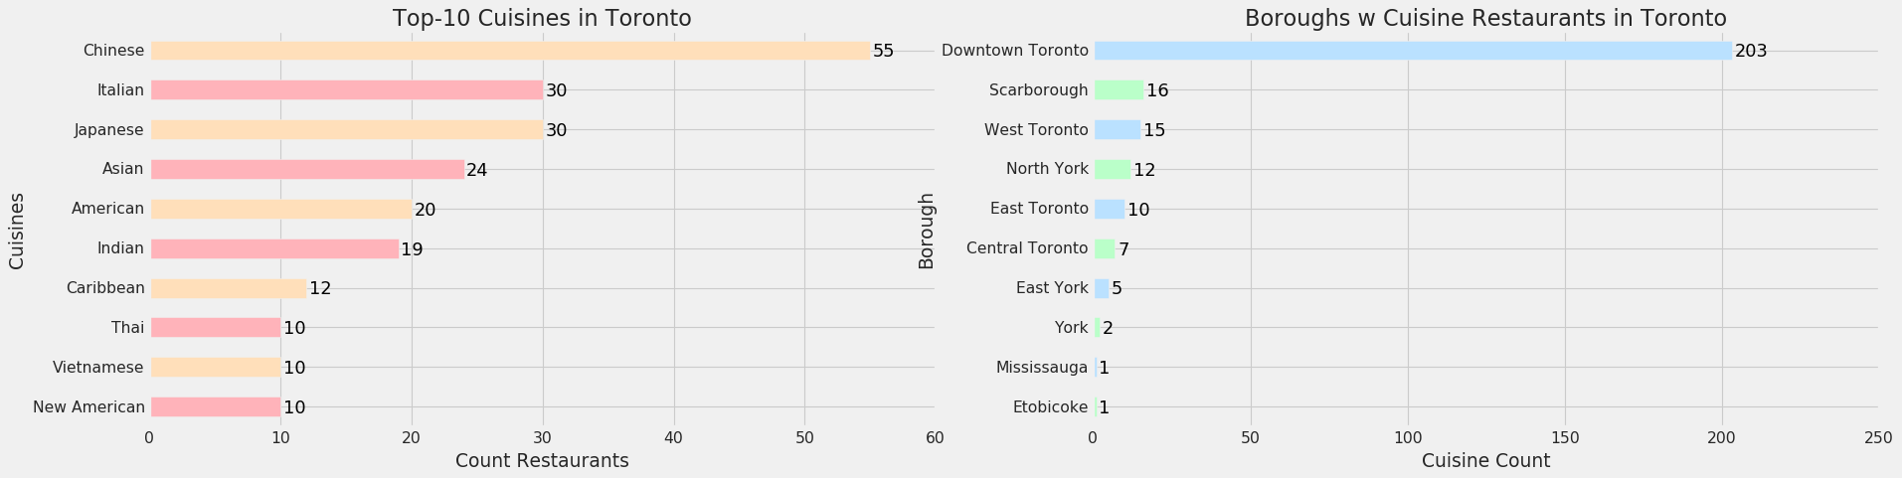
Visualization of the top cuisine data

Slide 12
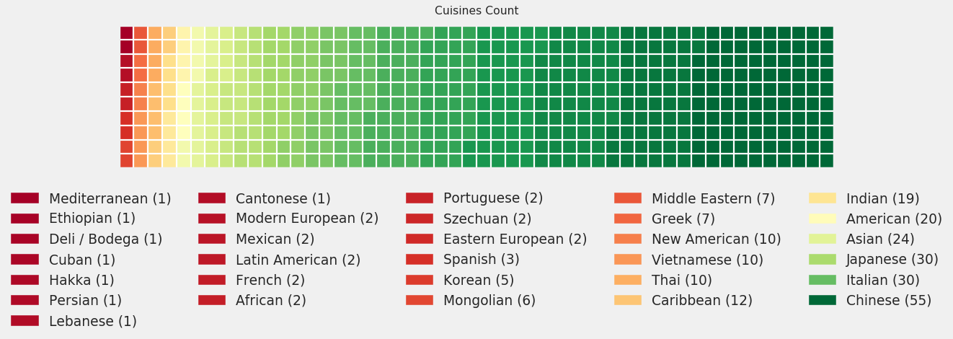
Visualization of the all cuisine data

Slide 13
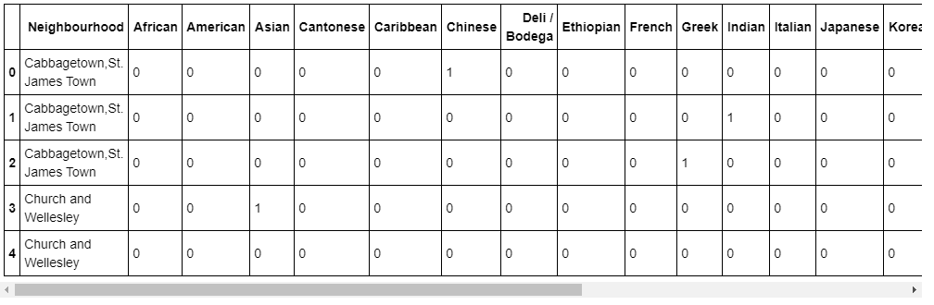
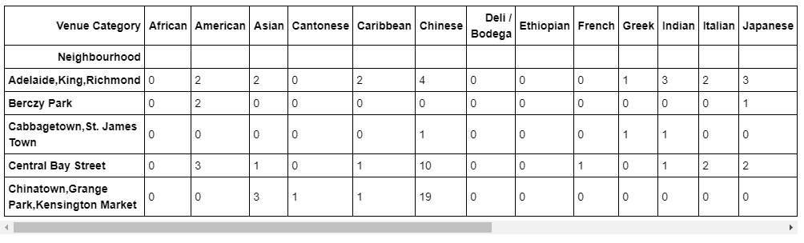
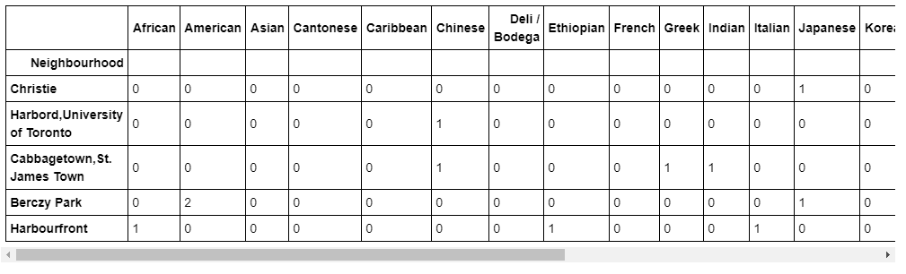
Cuisines in Downtown Toronto borough: neighborhoods

Slide 14
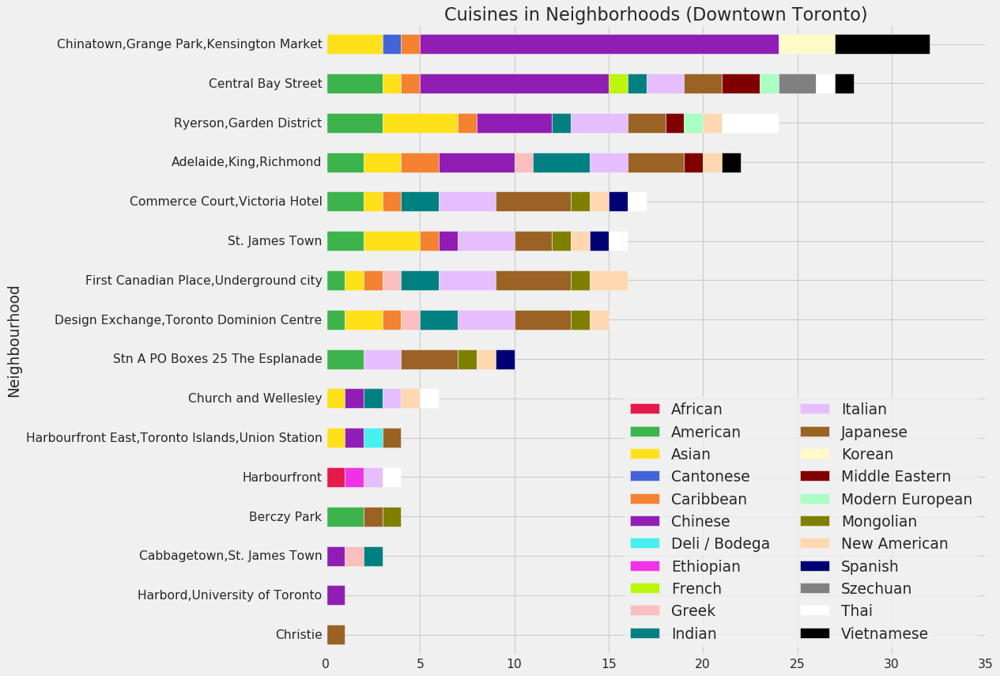
Cuisines in Downtown Toronto in barh plot

Slide 15
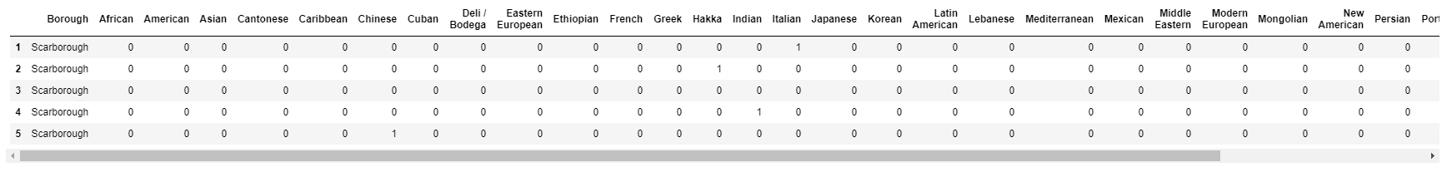
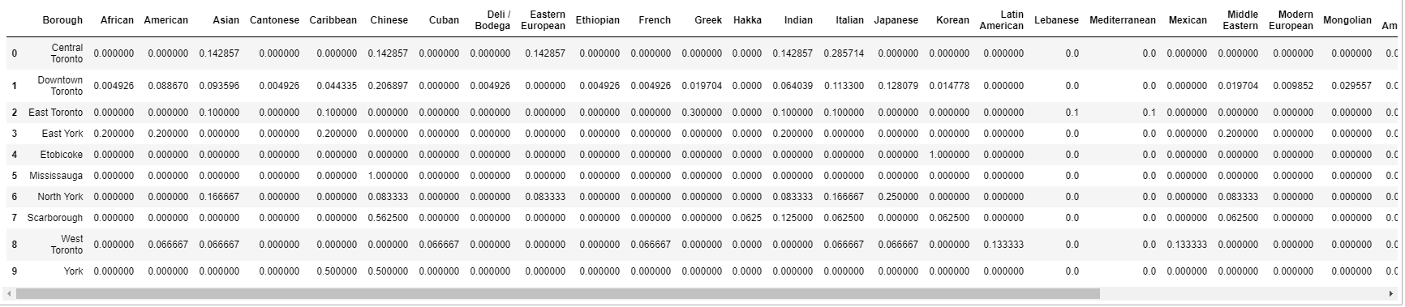
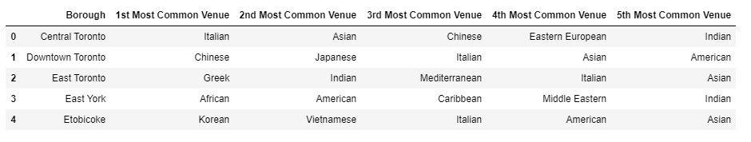
Preparing data for clusterization

Slide 16
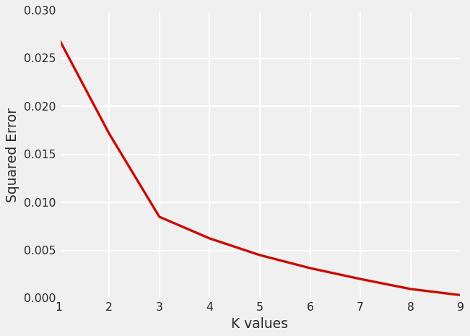
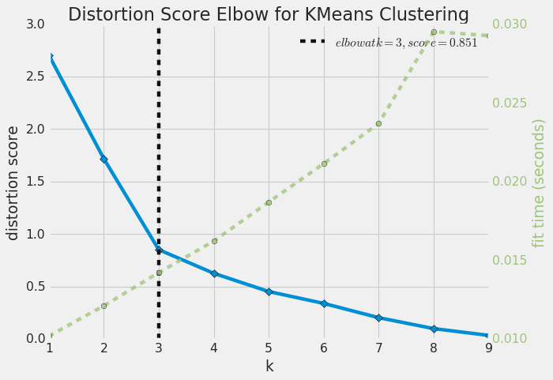
Choosing k-value based on squared error value

Slide 17
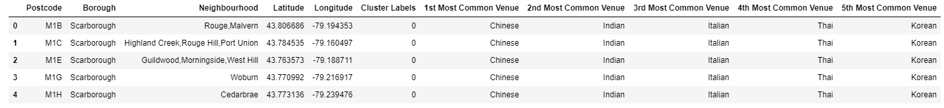
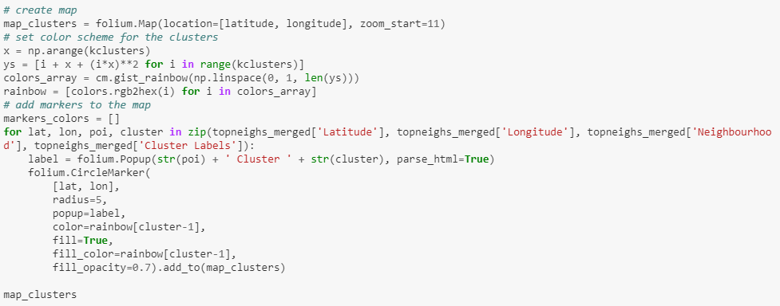
Showing the clusters on a map

Slide 18
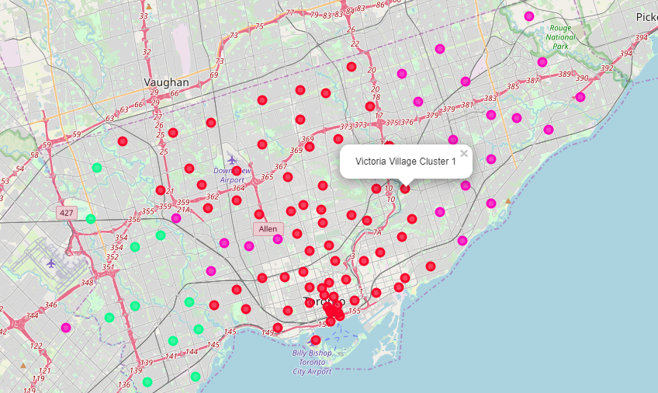
Three Toronto boroughs clusters

Slide 19
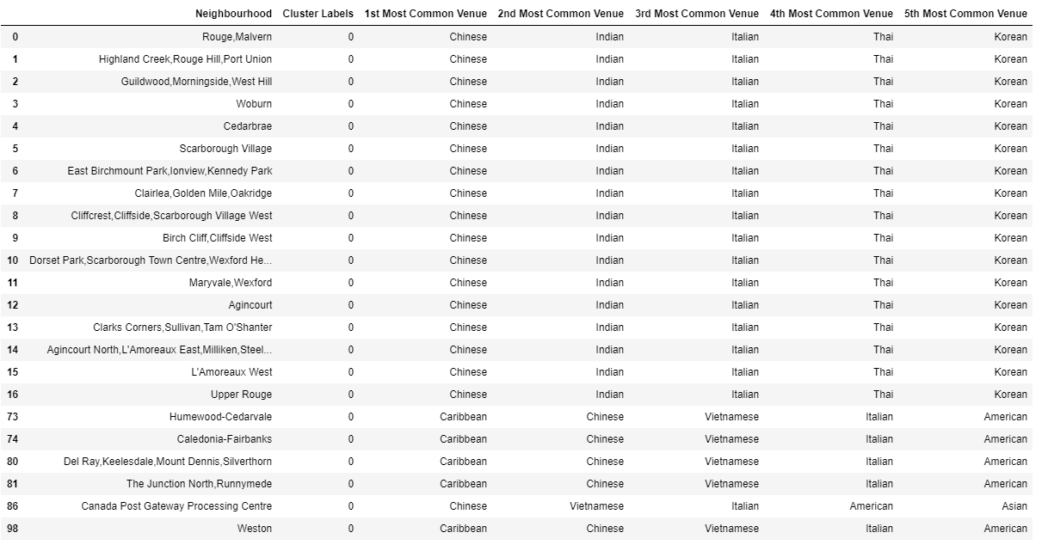
Cluster0 – mostly Chinese&Indian cuisine

Slide 20
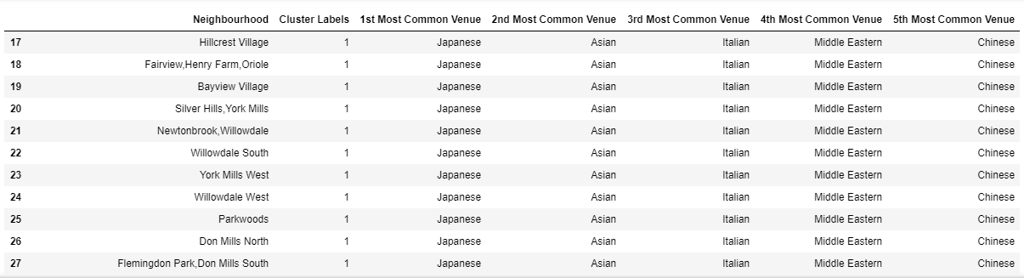
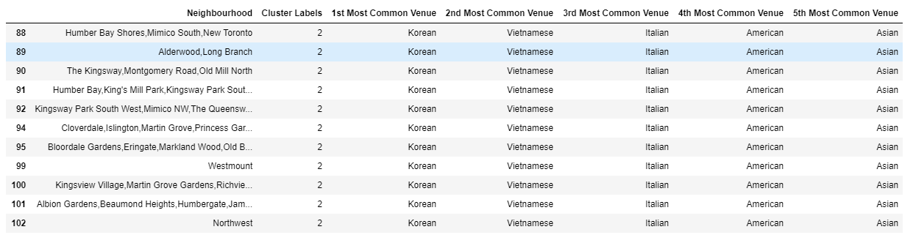
Cluster1 – mostly Japanese&Asian cuisine Cluster2 – mostly Korean&Vietnamese

Slide 21
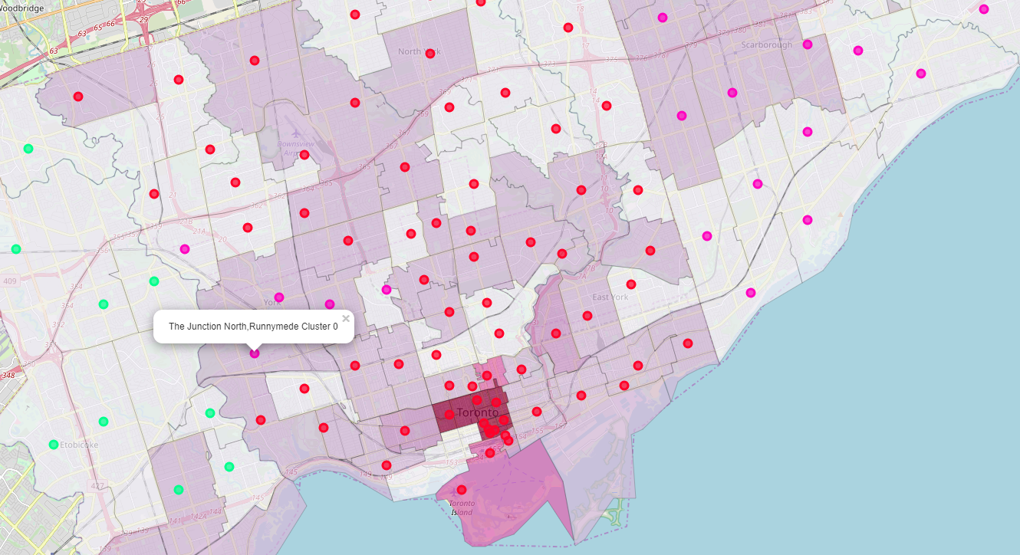
Combined map of restaurant count and cuisine clusters

Slide 22
Thank you for your attention

